Slide 1
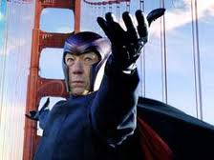
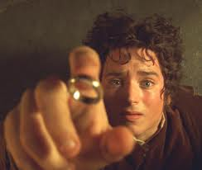
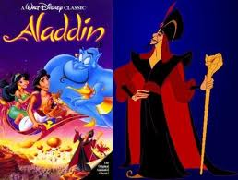
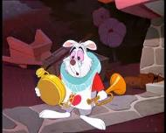
Examples of Round & Flat Characters
Round: Frodo Baggins from Lord of the Rings and X-Men’s Magneto are round characters because we know a lot about their personalities.
Flat: Jafar in Aladdin and the white rabbit in Alice… are flat because they possess few traits: Jafar is evil. The white rabbit is anxious and in a hurry.

